Slide 1
STOCK MARKET ANALYSIS AND PREDICTION USING MACHINE LEARNING
Presented By:
Lavanya R

Slide 2
Abstract
Stock Market Analysis and Prediction is a data science project that uses historical stock market data to analyze trends and predict future stock prices.
The project applies machine learning algorithms such as Linear Regression to forecast stock closing prices.
The system helps investors and analysts understand market behavior and make data-driven decisions.

Slide 3
Introduction
The stock market is an important financial platform where shares of companies are traded. Predicting stock prices is a challenging task because market values change continuously.
Machine learning techniques can analyze historical stock data and identify patterns to estimate future prices.
This project uses stock market datasets and machine learning algorithms to perform prediction and analysis.

Slide 4
Problem Statement
Investors often face difficulties in predicting future stock prices due to market fluctuations and large amounts of financial data.
Manual analysis is time-consuming and may not provide accurate results.
Therefore, an automated prediction system is required to analyze historical stock prices and predict future market trends.

Slide 5
Existing System
Manual stock market analysis.
Depends on expert knowledge.
Time-consuming process.
Difficult to analyze large datasets.
Less efficient in predicting future prices.

Slide 6
Limitations
Human errors.
Slow decision making.
Limited accuracy.

Slide 7
Proposed System
Uses Machine Learning techniques.
Analyzes historical stock data.
Predicts stock closing prices automatically.
Provides accurate and faster predictions

Slide 8
Advantages
Automated analysis.
Better prediction accuracy.
Faster processing.
Easy visualization using graphs.

Slide 9
System Architecture
Stock Dataset
Data Preprocessing
Train-Test Split
Machine Learning Algorithms
Linear Regression
Performance Evaluation
Prediction Output
User Input Prediction

Slide 10
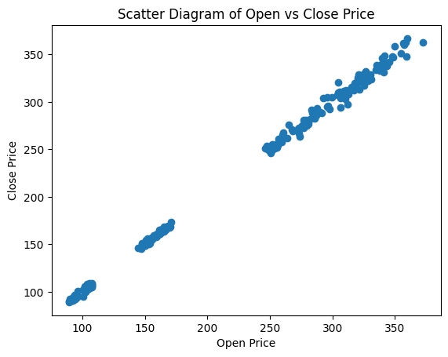
Index(['Ticker', 'Date', 'Open', 'High', 'Low', 'Close', 'Adj Close',
'Volume'],
dtype='object')

Slide 11
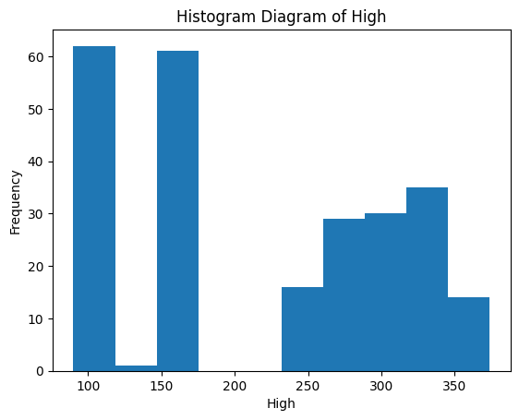

Slide 12
Modules
1. Data Collection Module
2. Data Preprocessing Module
3. Data Visualization Module
4. Model Training Module
5. Model Comparison Module
6. Prediction Module
7. Model Saving and Loading Module

Slide 13
Module Overview
Data Collection Module
Collect stock market data from CSV dataset.
Data Preprocessing Module
Handle missing values and prepare data.
Data Visualization Module
Generate scatter plots and histograms.

Slide 14
Module Overview
Model Training Module
Train Linear Regression Model
R² Score Prediction Module
Predict stock closing prices using user input.
Model Saving Module
Save trained model using Joblib.

Slide 15
Results
Dataset successfully loaded.
Scatter and Histogram graphs generated.
Linear Regression model trained.
Accuracy performed.
Best algorithm selected.
Stock price prediction completed successfully.

Slide 16
Results
Measures Predicted error: 7.945050722582899
Measures Model Performance: 0.9990261566083692

Slide 17
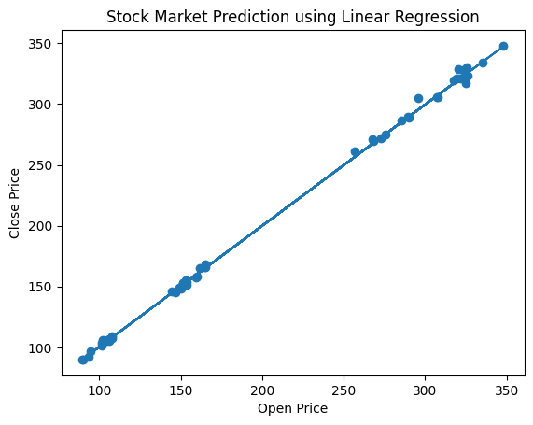
Measures Predicted error: 7.945050722582899
Measures Model Performance: 0.9990261566083692

Slide 18
Conclusion
The Stock Market Analysis and Prediction system successfully predicts stock closing prices using machine learning techniques.
The project demonstrates how historical stock data can be analyzed to generate accurate predictions. Linear Regression model provide effective forecasting results for stock market analysis.

Slide 19
References
1. Python Documentation
2. Scikit-learn Documentation
3. Pandas Documentation
4. Matplotlib Documentation
5. Kaggle Stock Market Dataset
6. Machine Learning Research Papers

Slide 20
Thank you

